Slide 1
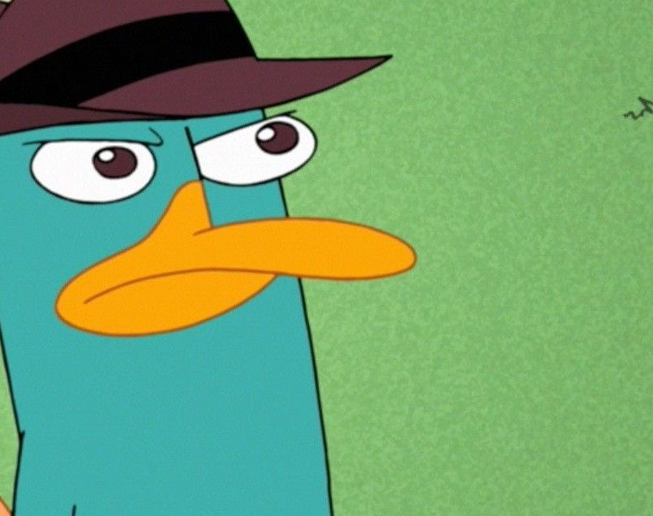

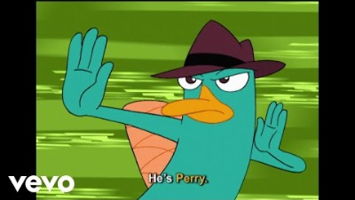
Cool Ducks
Tony Guy
Iasia Cooper
Antonio Vallez
Thaddeus Ellis
Benny Baker
Mentors:
Dr. Malcom Dcosta
Dr. Mohamed Elbakary

Slide 2
Student Contacts
Tony Guy "Tony Guy" ttguy983@students.ecsu.edu
Iasia Cooper "Iasia Cooper" iacooper760@students.ecsu.edu
Thaddeus Ellis "Thaddeus Ellis" tellis772@students.ecsu.edu
Antonio Vallez "Antonio Vallez" arvallez113@students.ecsu.edu
Benny Baker "Benny Baker" bbaker550@ecsu.edu

Slide 3
Mentor Contacts
Dr. Malcolm Dcosta "Malcolm Dcosta" mtdcosta@ecsu.edu
Dr. Mohammed Elbarary "Mohamed Elbakary" melbakary@ecsu.edu

